Slide 1
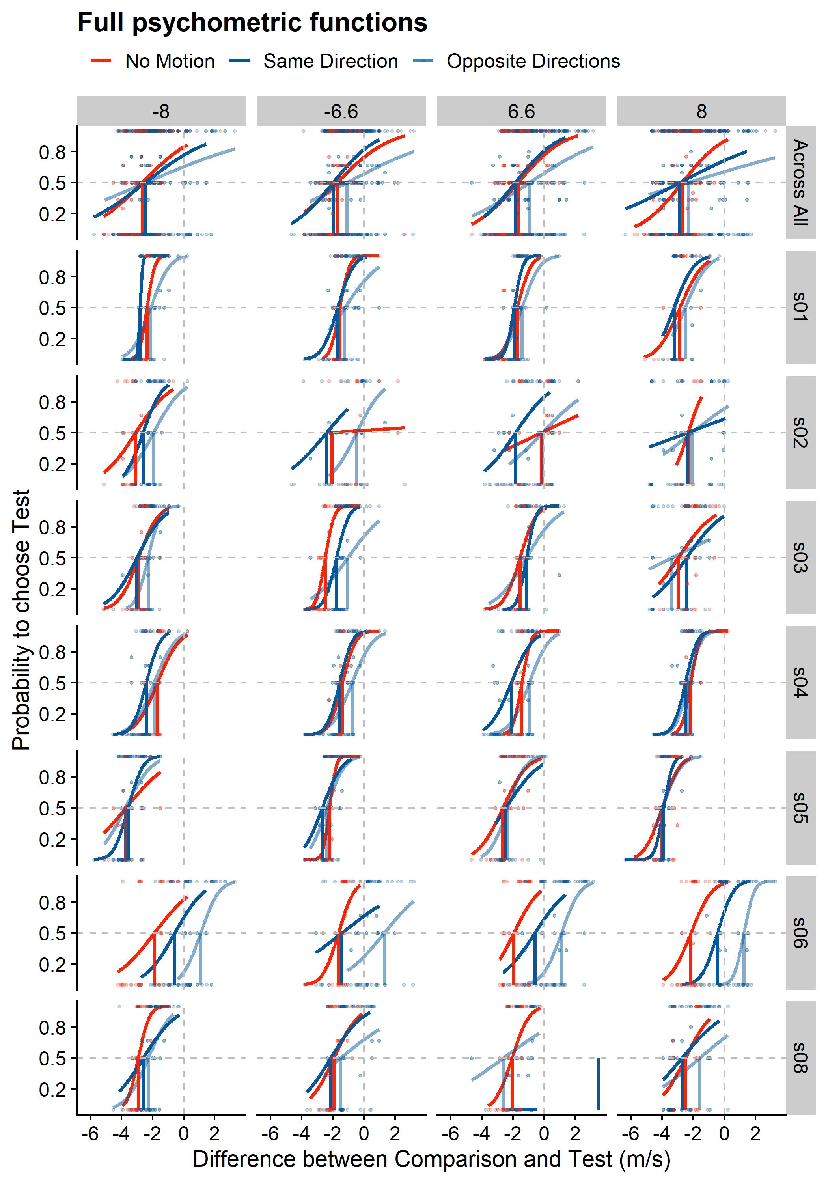
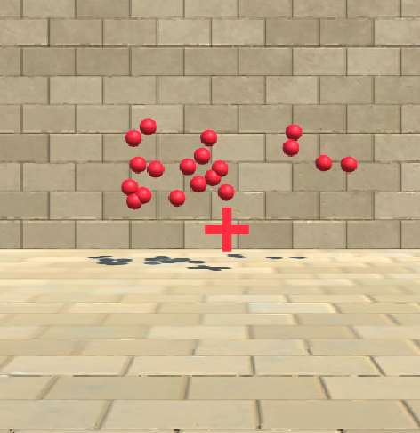
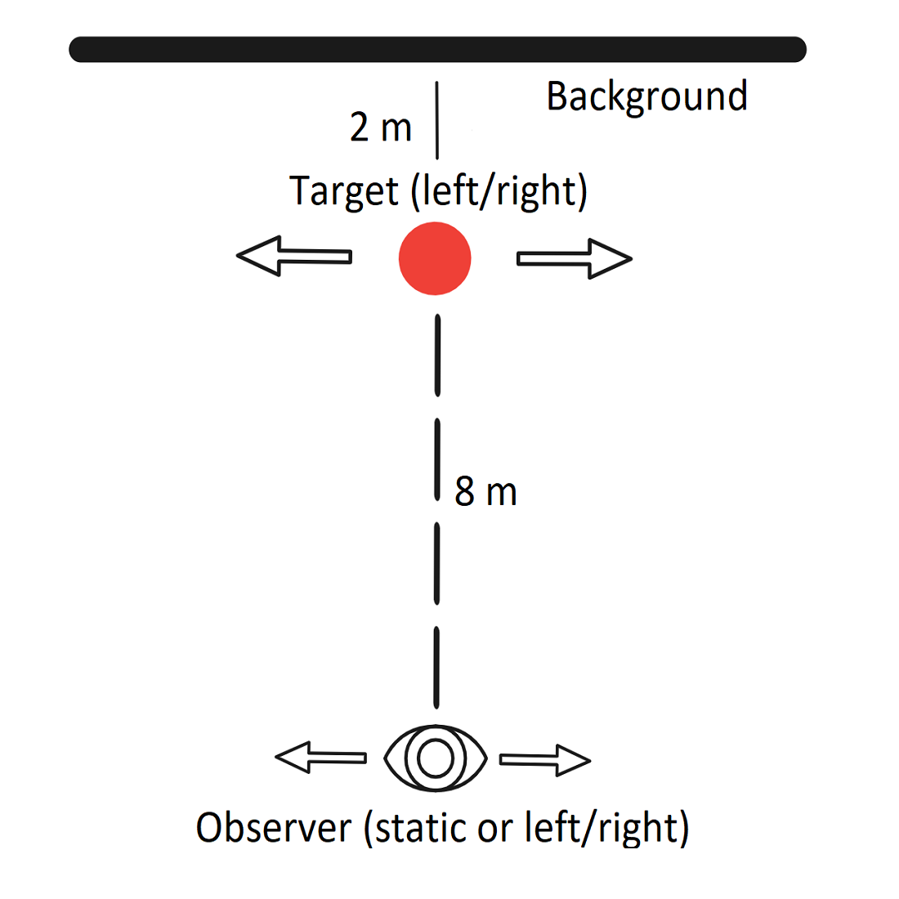
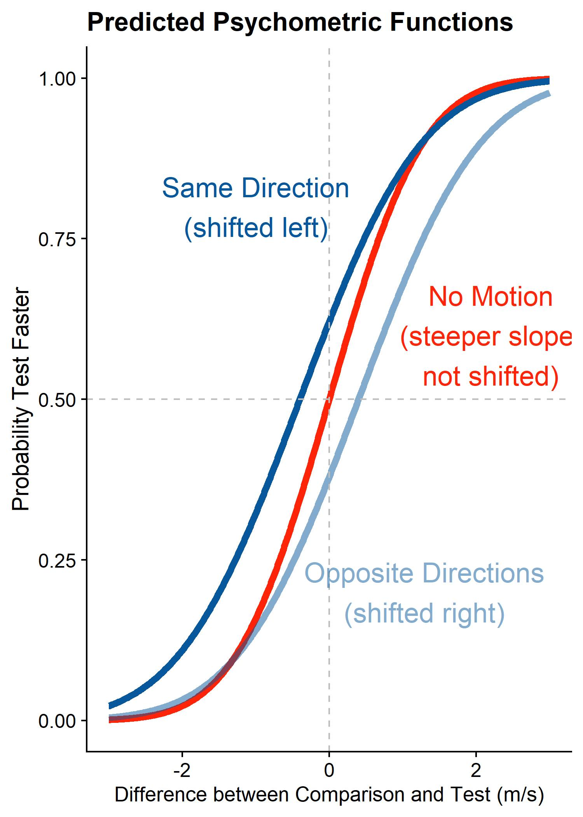
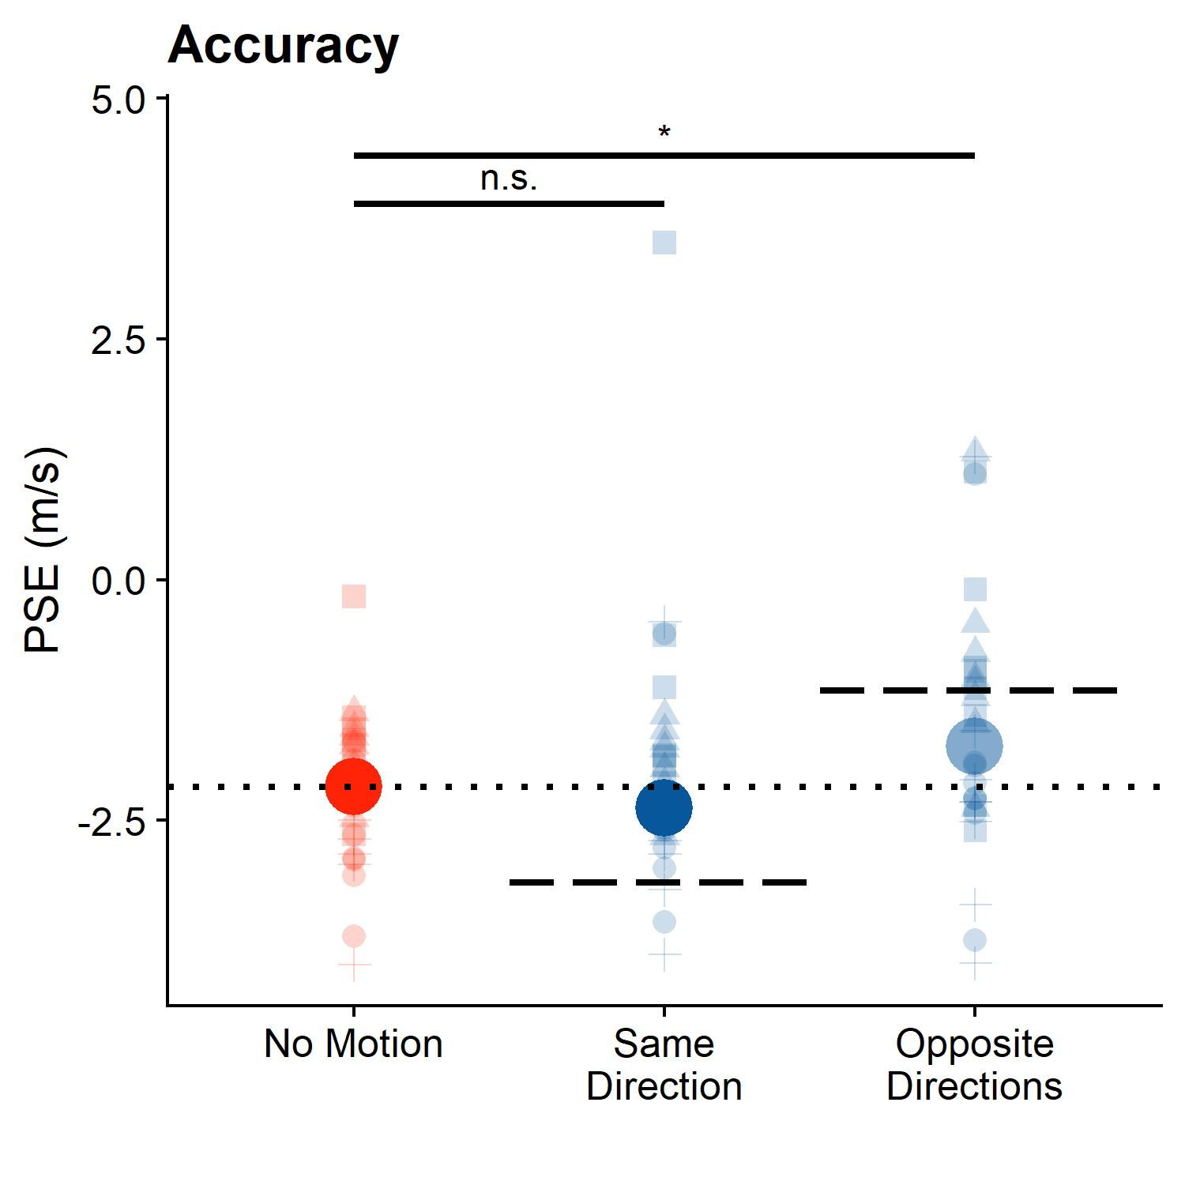
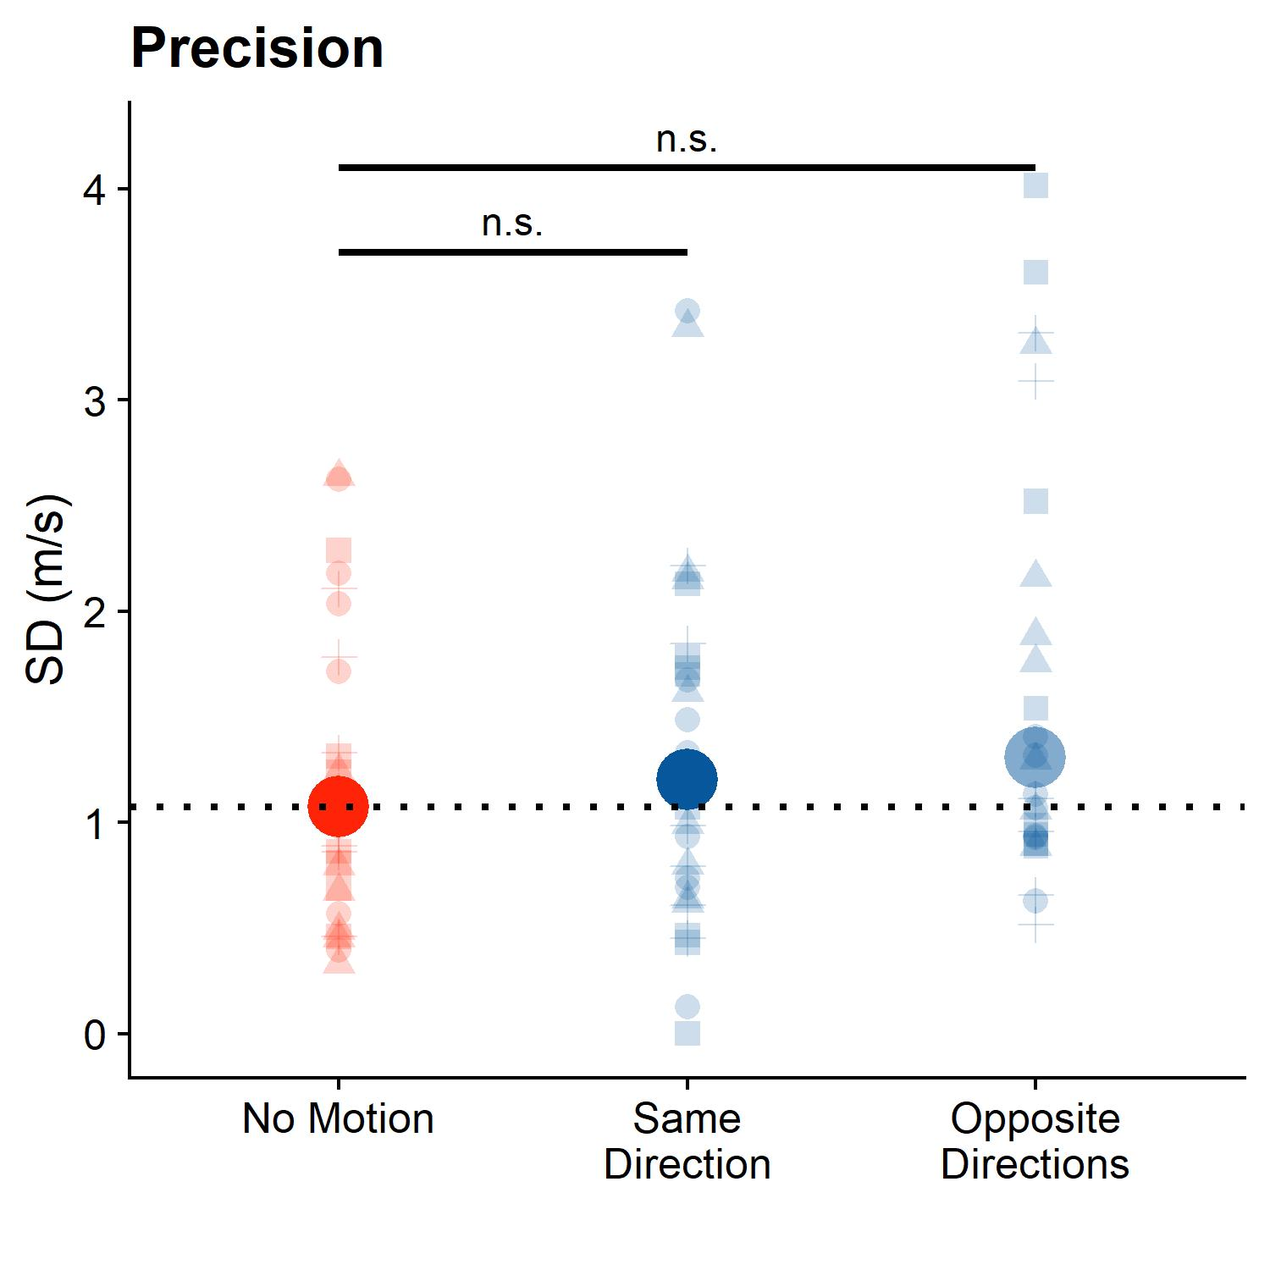


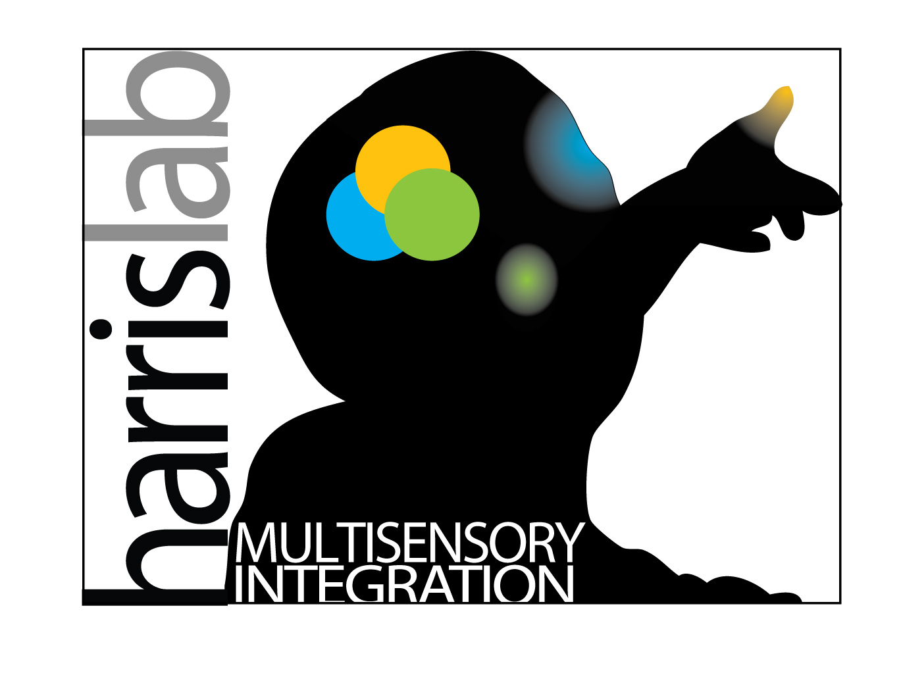



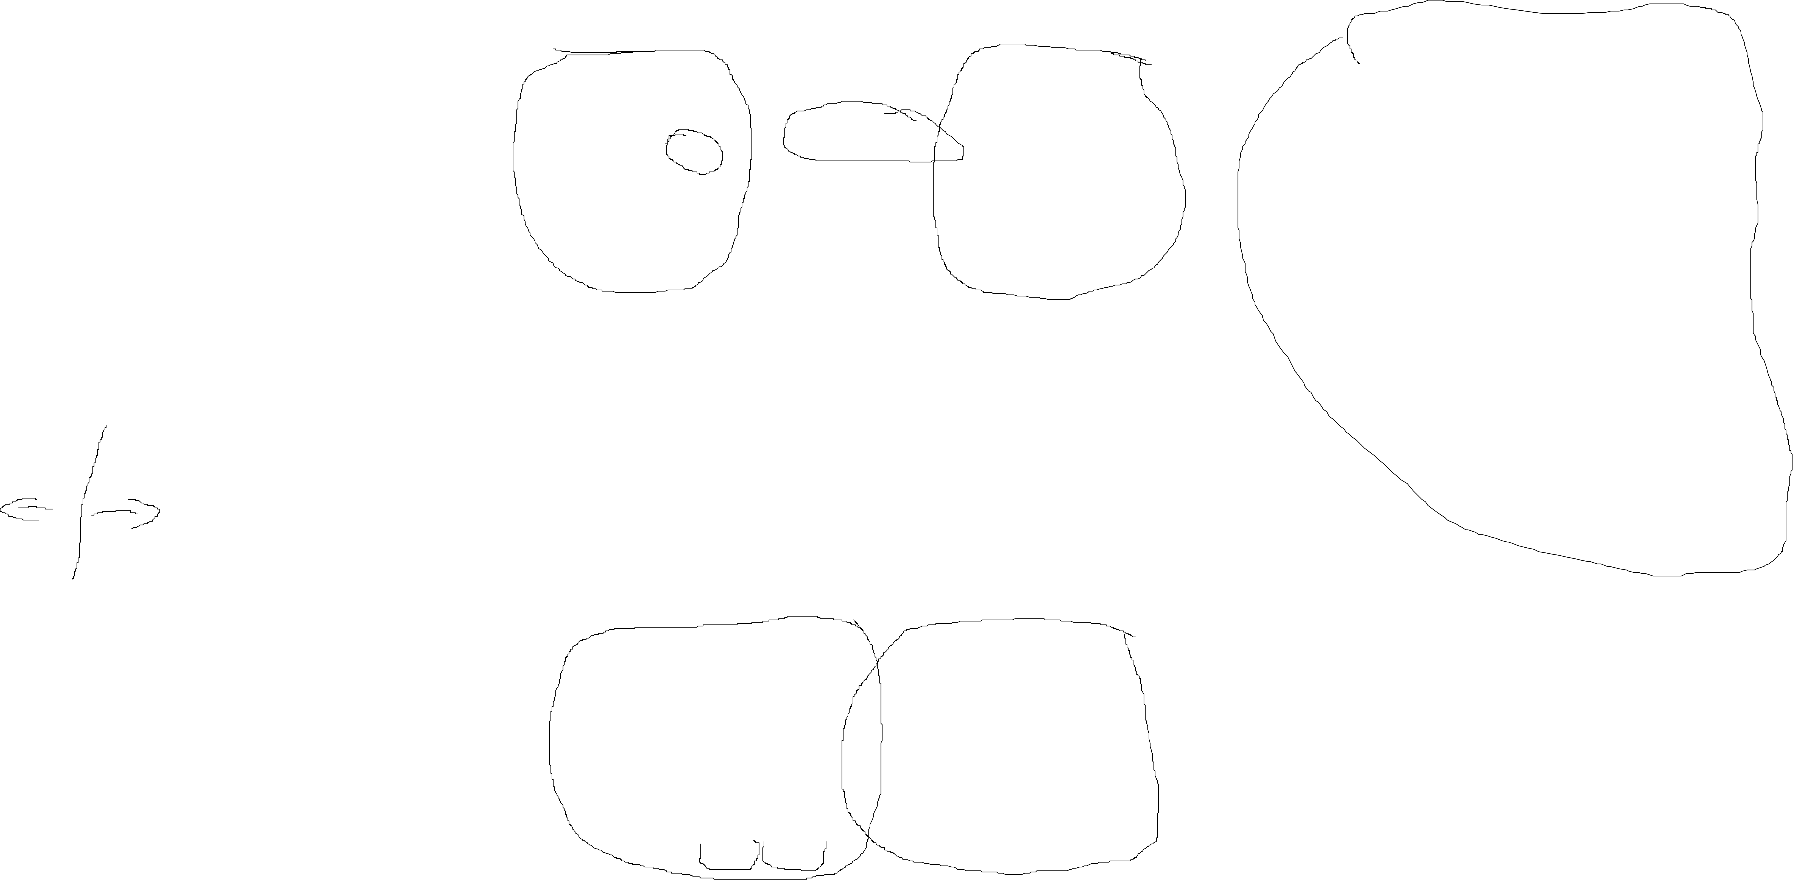
Incomplete Compensation for Visual Self-Motion in the Perception of Object Velocity
Björn Jörges, Laurence R. Harris
Center for Vision Research, York University
bjoerges@yorku.ca
Twitter: @b_jorges
Background & Objectives
Methods
Retinal motion elicited by an object is ambiguous and can be due to:
object motion
self motion
Estimating self-motion is a multisensory process:
vestibular
visual
efference copies
Can we compensate for self-motion in the absence of efference copies and vestibular cues? Does compensation decrease precision?
TEST: SAME DIRECTION TRIAL
COMPARISON
TEST: OPPOSITE DIRECTION TRIAL
-8 m/s
-6.6 m/s
6.6 m/s
8 m/s
motion from self-motion (optic flow)
motion from self-motion (optic flow)
Figure 4: Psychometric functions per participant (rows of panels; the first row with the blue shading shows the psychometric functions fitted across participants) and standard velocity (columns of panels); negative velocities correspond to leftwards object motion. The cross made up of dashed lines indicates perfect accuracy. The translucent dots correspond to response fractions per stimulus strength. We flipped responses around for leftwards motion to make the psychometric functions more easily comparable.
motion from object-motion
motion from object-motion
self motion
No observer motion
self motion
Figure 2a: Participant view – test, same directions condition
Figure 2b: Participant view – comparison
Figure 2c: Participant view – test, opposite directions condition
The task: Which of two presented motions is faster?
Hypothesis 1: self-motion and object motion in the same direction in absence of vestibular cues /efference cues lead to am inadequate compensation, i.e., an underestimation of target velocity, and to an overestimation of target velocity when self-motion and object motion are in opposite directions
Prediction 1: curve shifted left (for same direction) or right (for opposite directions) indicating lack of compensation
Hypothesis 2: self-motion leads to noisier judgments
Prediction 2: Psychometric function shallower when self-motion is present
The stimuli (GIF available here)
Two motion intervals presented at eye-height in 3D virtual environment
One big target (6.6 or 8 m/s left or right; Fig. 2a/2c), one ball cloud (velocity PEST staircase-controlled, Fig. 2b, with up to 35 trials per staircase)
Figure 2d: top view of stimulus
Participant moved visually in the same or opposite direction as the target, or static during observation of big target (Gaussian motion profile, 1 m/s average speed across 0.5 s); no physical motion
Dependent variables: Mean and slope of psychometric function
Ball cloud perceived as much faster than single target (consistently negative PSEs)
Hypothesis 1: On average, motion in the opposite direction is judged as too fast (p < 0.05, about 70% compensation) and motion in the same direction is judged roughly as accurately as no motion (p = 0.8, nearly full compensation)
Hypothesis 2: On average, subjects judge speed somewhat less precisely when self-motion is simulated (p = 0.11 for Same Direction and p = 0.13 for Opposite Directions)
Results
A.
B.
Figure 1: Predicted psychometric functions
Open Science, Acknowledgments & References
All resources, including a Stage 1 Registered Report submitted to Attention, Perception and Attention, are available here. We thank the Canadian Space Agency for partial funding of this project.
0% compensation
Conclusions
VISTA
100% compensation
0% compensation
We compensate nearly fully for self-motion in the same direction as the target, and about 70% for motion in the opposite direction, even when vestibular and efference copy cues are unavailable. Precision was slightly lower for both self-motion conditions, but comparable between them. This is a surprising preliminary result, as previous results (Dokka et al., 2015) suggest that more complete compensation should come at a higher cost in terms of precision.
Figure 3: A & B. Big solid dots – median PSEs (A) and SDs (B) of the psychometric functions across participants and velocities. Translucent dots – data per participant and standard velocity. Dotted lines – median value for stationary observer. A. The dotted line also corresponds to 100% compensation for Same Direction and Opposite Directions conditions. Dashed lines correspond to the expected value for 0% compensation for self-motion.
[1] Dokka, K., MacNeilage, P. R., DeAngelis, G. C., & Angelaki, D. E. (2015). Multisensory self-motion compensation during object trajectory judgments. Cerebral Cortex, 25(3), 619–630. https://doi.org/10.1093/cercor/bht247
[2] Dupin, L., & Wexler, M. (2013). Motion perception by a moving observer in a three-dimensional environment. Journal of Vision, 13(2), 1–14. https://doi.org/10.1167/13.2.15
Notes:
Thank you for e-coming to my poster. In our project, we looked at how we perceive object motion during visually simulated self-motion. To estimate object motion during self-motion correctly, we first need to estimate self-motion. We then need to subtract retinal stimulation due to self-motion from the overall retinal stimulation if we want to get retinal stimulation due to object motion. The perception of self-motion is a multisensory process, and we would expect some things to go wrong when self-motion is signalled only visually, but not vestibularly, for example. So we would expect self-motion generally to be underestimated. This in turn would result in an overestimation when observer and object move in opposite directions and in an underestimation when observer and object move in the same direction. Also, this seems to be a pretty noisy process, so the more we compensate for self-motion, the noisier these judgments should get. We tested these hypotheses with a psychophysical two-interval foirced-choice task. We showed participants two intervals of motion, one was a big target ball and the other was a cloud of balls. Our participants had to tell on each trial which interval was faster. While observing the big target ball, participants were sometimes moved visually in the same direction as the target, and sometimes they were moved visually in the opposite direction. The speed of the big target was fixed, and the speed of the ball cloud was regulated via a PEST staircase. The dependend variables were the means and slopes of the psychometric functions. Per our hypotheses, we would expect the psychometric functions to be shifted to the left when observer and target move in the same direction, and to the right when observer and target move in opposite directions. Also, the psychometric functions should be steeper when no self-motion is simulated. That is, as it tends to go in science, only sort of what we found. You have here the means of the psychometric function as a measure of accuracy and here the standard deviations of the psychometric function as a measure of precision. For accuracy, the big dots represent the means across participants, the dashed line would be the expected value when we don‘t compensate at all for self-motion and the dotted line would be the expected value when we compensate fully for self-motion, which is the same value as when there is no self-motion simulated visually. We see that the compensation is nearly perfect when participants move in the same direction as the target, and its more than half-way there when they move in the opposite direction of the target. For precision, the dotted line corresponds again to the value when no self-motion is simulated, and we can see t hat for both self-motion conditions, the median value is slightly above the line, but these differences are not significant. Here you can see also all psychometric functions for all participants, and you see there is a lot of noise, so we are really looking forward to being able to run more participants, hopefully in the near future. All in all, our data indicate that we perceive object-motion in the same direction as self-motion roughly accurately, while we compensate for self-motion in the opposite direction at about 70%. The precision seems to be lower for both self-motion conditions, which is a bit surprising, as previous results suggest that higher compensation should come with a higher precision cost. But we only have seven participants so far and don‘t want to make any grand claims just yet.

